Slide 1
Combinational Logic
Chapter 2-3
COMP121 Computer Architecture

Slide 2
Outline
.
Combinational Circuit
Half Adder
Full Adder
Decoder
Multiplexer
COMP121 Computer Architecture

Slide 3
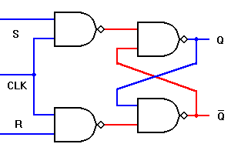
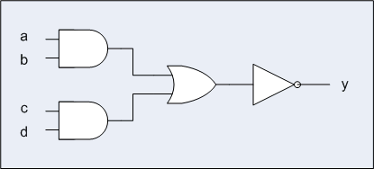
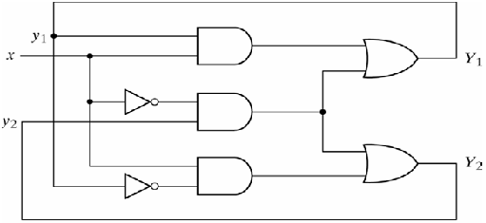
Combinational Circuit
.
Combinational Circuit: consists of logic gates whose outputs at any time are determined from the present combination of inputs.
Sequential Circuit
Combinational Circuit
COMP121 Computer Architecture

Slide 4
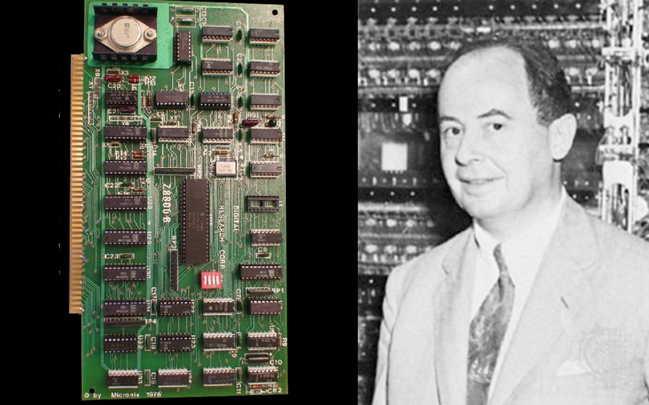
Computer Arithmetic
2.2 First: Because the device is primarily a computer, it will have to perform the elementary operations of arithmetic most frequently. These are addition, subtraction, multiplication and division. It is therefore reasonable that it should contain specialized organs for just these operations.
It must be observed, however, that while this principle as such is probably sound, the specific way in which it is realized requires close scrutiny.... At any rate a central arithmetical part of the device will probably have to exist and this constitutes the first specific part: CA.
COMP121 Computer Architecture

Slide 5
Arithmetic Operation
Digital computers perform a variety of information processing tasks. Among the functions encountered are the various arithmetic operations. The most basic arithmetic operation is the addition of two binary digits.
This simple addition consists of four possible elementary operations:
0+0 = 0
0+1 = 1
1+0 = 1
1+1 = 10 (logical operation is 1+1=1)
COMP121 Computer Architecture

Slide 6
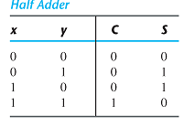
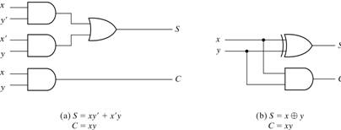
Half Adder
Two binary inputs and two binary outputs.
The sum output is
S=x'y+xy'
The carry output is
C = xy
COMP121 Computer Architecture

Slide 7
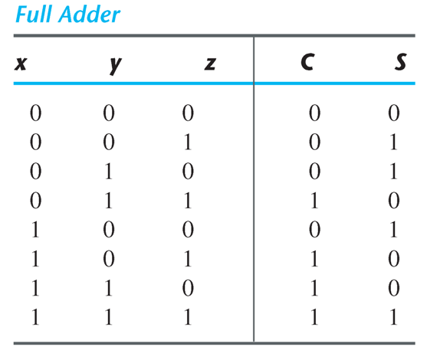
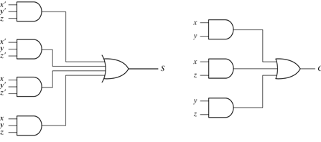
Full-Adder
Full-adder (FA): is a combinational circuit that forms the arithmetic sum of three bits. It consists of three inputs and two outputs.
The sum output is
S = xy'z' + x'yz' + xyz + x'y'z
The carry output is
C = xy'z + x'yz + xy
COMP121 Computer Architecture

Slide 8
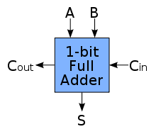
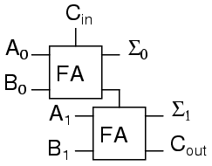
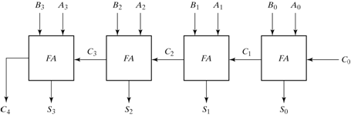
Block Diagram of Binary Adders
A₁A₀+B₁B₀+C_{in}
A+B+C_{in}
A₃A₂A₁A₀+B₃B₂B₁B₀+C₀
COMP121 Computer Architecture

Slide 9
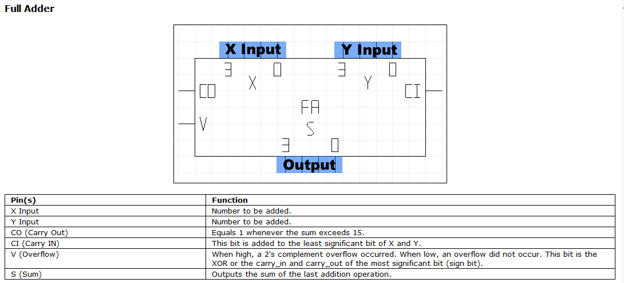
Full Adder in the Simulator
COMP121 Computer Architecture

Slide 10
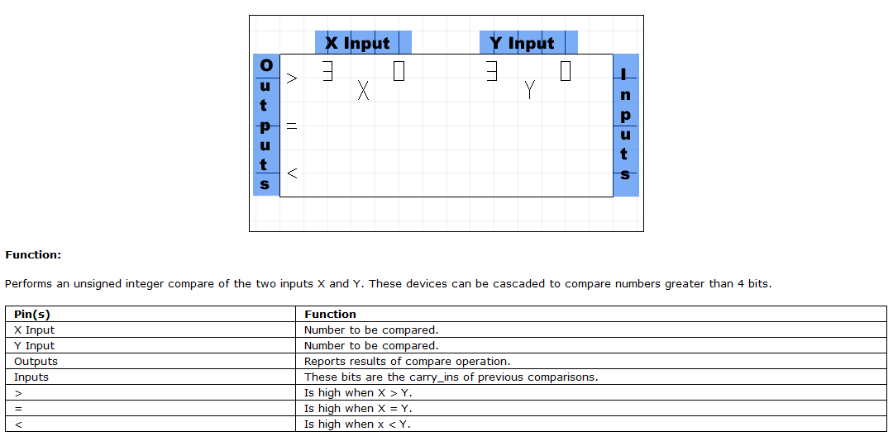
Comparator in the Simulator
COMP121 Computer Architecture

Slide 11
Control Unit
2.3 Second: The logical control of the device, that is, the proper sequencing of its operations, can be most efficiently carried out by a central control organ. If the device is to be elastic, that is, as nearly as possible all purpose, then a distinction must be made between the specific instructions given for and defining a particular problem, and the general control organs which see to it that these instructions - no matter what they are - are carried out. The former must be stored in some way the latter are represented by definite operating parts of the device. By the central control we mean this latter function only, and the organs which perform it form the second specific part: CC.
COMP121 Computer Architecture

Slide 12
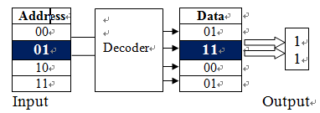
Decoders
Decoder:
a combinational circuit that converts binary information from n input lines to a maximum of 2^n unique output lines.
For Addressing
COMP121 Computer Architecture

Slide 13
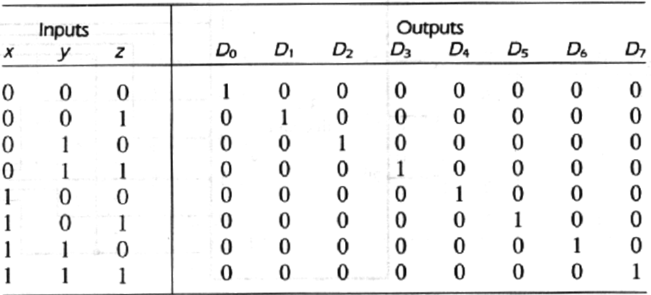
3-to-8-Line Decoder
For each possible input combination, there are seven outputs that are equal to 0 and only one that is equal to 1.
COMP121 Computer Architecture

Slide 14
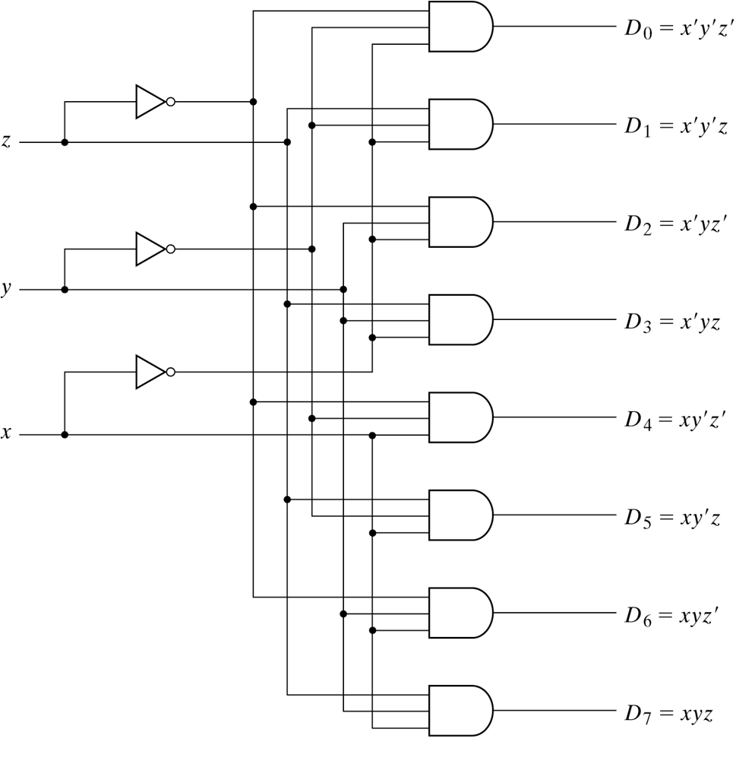
Structure of
3-to-8 Decoder
COMP121 Computer Architecture

Slide 15
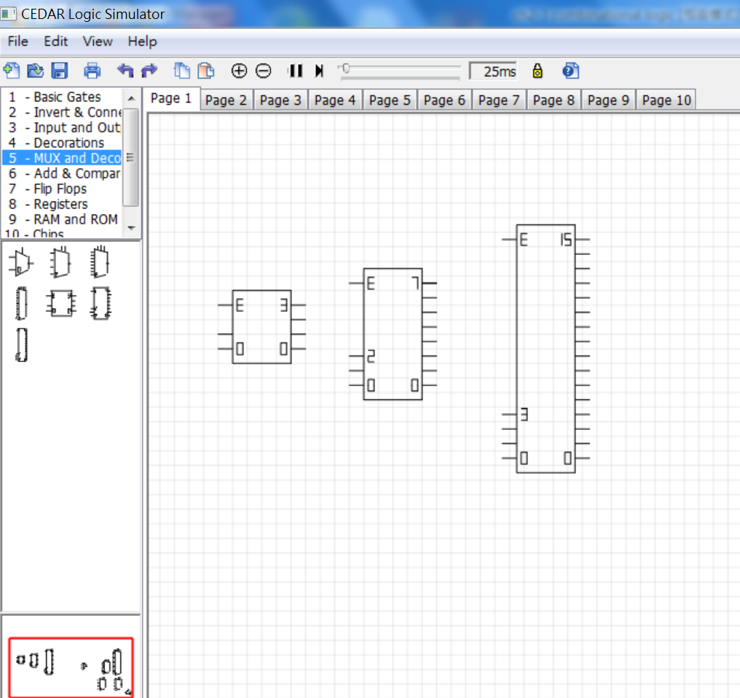
Block Diagram of Decoders
Decoders
2-to-4
3-to-8
4-to-16
Demo
1
2
3
COMP121 Computer Architecture

Slide 16
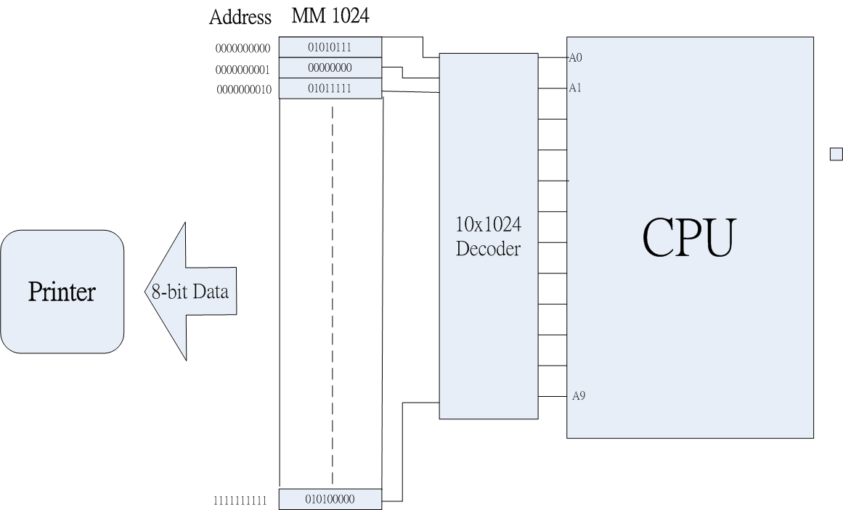
Decoder and Address
COMP121 Computer Architecture

Slide 17
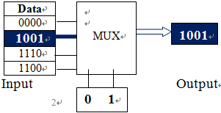
Multiplexer
Multiplexer: a combinational circuit that selects binary information from one of many inputs lines and direct it to a single output line. The selection of a particular input line is controlled by a set of selection lines. Normally, there are 2^n input lines and n selection lines whose bit combinations determine which input is selected.
Channel 2
For Channel Selection
COMP121 Computer Architecture

Slide 18
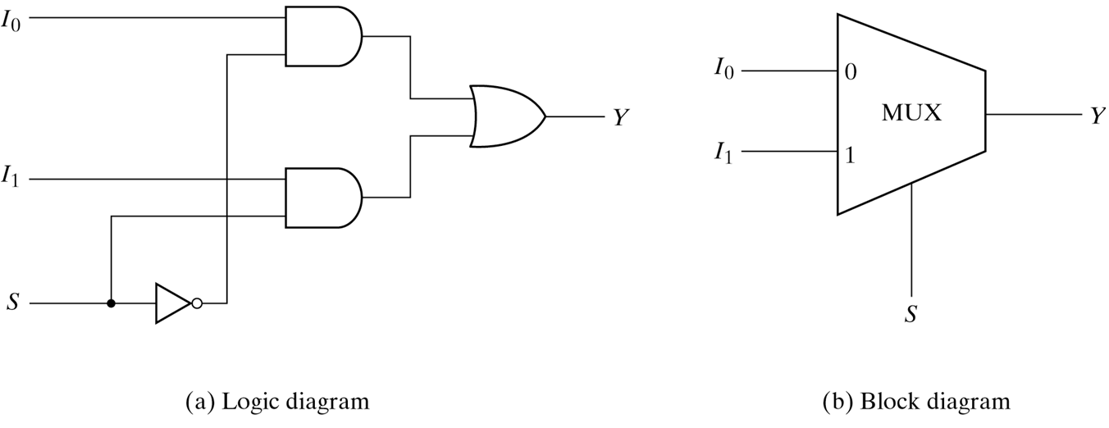
2-to-1 Line Multiplexer
The circuit has two data input lines, one output line, and one selection line S. When S = 0, the upper AND gate is enabled and I_{o} has a path to the output. When S = 1, the lower AND gate is enabled and I_{l} has a path to the output.
COMP121 Computer Architecture

Slide 19
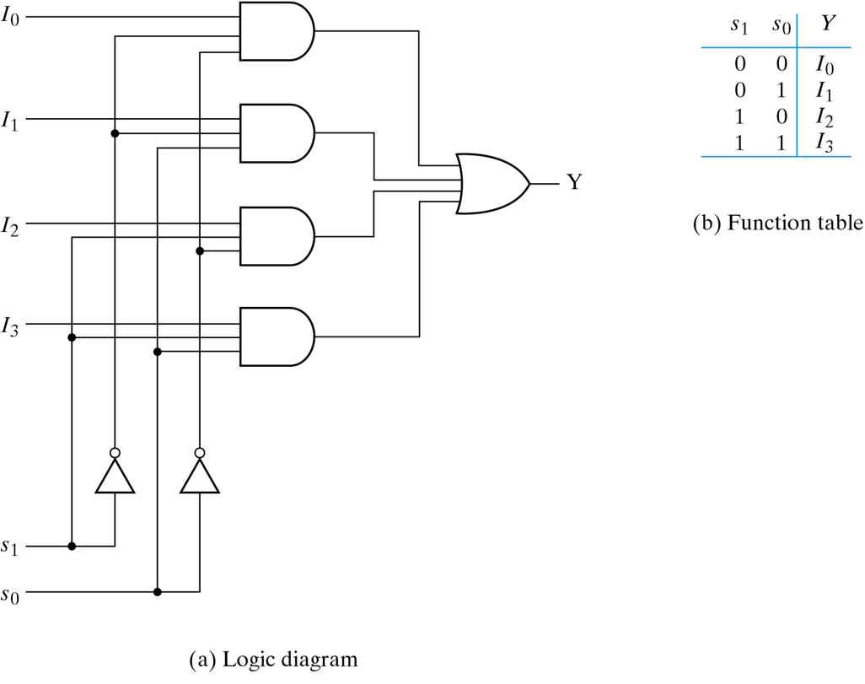
4-to-1 Line Multiplexer
Structure of
4-to1 MUX
COMP121 Computer Architecture

Slide 20
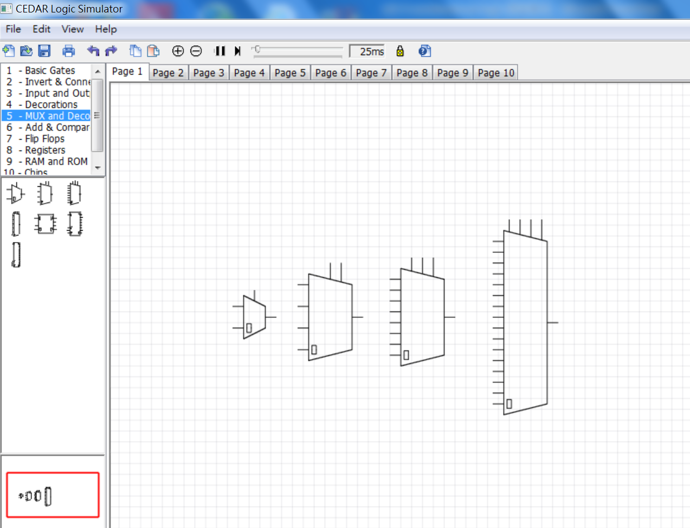
Block Diagram of Multiplexers
Multiplexers
2-to-1
4-to-1
8-to-1
16-to-1
1
2
3
1
2
3
4
Demo
COMP121 Computer Architecture

Slide 21
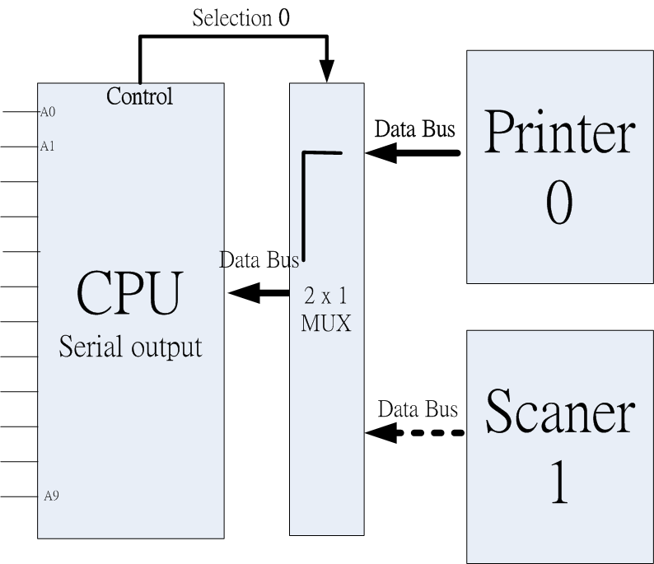
MUX and Data Bus
COMP121 Computer Architecture

Slide 22
Decoder, MUX and Computer
Select a channel
Such as Data bus
Select a component
For example a memory address
COMP121 Computer Architecture

